Slide 1
Quality assurance 2018
What is happening?
TASC approval of plans/scope & sequence (SDI, Project Implementation, Work Readiness)
Full-day on-site audits
Focused audits
Desktop audits
QA Regional Workshop meeting
QA Meetings for selected Level 2 courses

Slide 2
Focused Audits
same standards and process as full-day audits
focus on two courses
‘snapshot’ approach vs ‘bigger picture’: less time but patterns not necessarily seen
an addition – not a replacement – to more extensive provider audits.

Slide 3
Desktop audits
two courses selected for desktop audit in 2018: Chinese – Foundation; and Essential Skills – Reading and Writing
selected providers have been contacted and asked to provide TASC with a variety of delivery and assessment documentation
TASC will analyse the documentation and give feedback to providers
remedial actions may be required if issues emerge from analysis

Slide 4
QA Regional Network Meeting
latest has been held at Lilydale (selected schools in the NE and E)
2018 selected courses: Essential Skills – Using Computers and the Internet; and maths (Essential Skills – Maths, Workplace Maths)
school representatives undertake guided self- and small-group evaluation of delivery and assessment documentation and procedures

Slide 5
QA Regional Network Meeting
emphasis on sharing experiences, learning from others and networking
emphasis on identifying current strengths
emphasis on identifying opportunities for improvement
key learning from review of selected courses used to develop a Quality Assurance Improvement Plan to guide each school’s future growth in delivery and assessment methodologies

Slide 6
QA MeetingS for selected Level 2 courses: September

Slide 7
Regional and statewide meetings
Ulverstone
Devonport
Launceston
Hobart

Slide 8
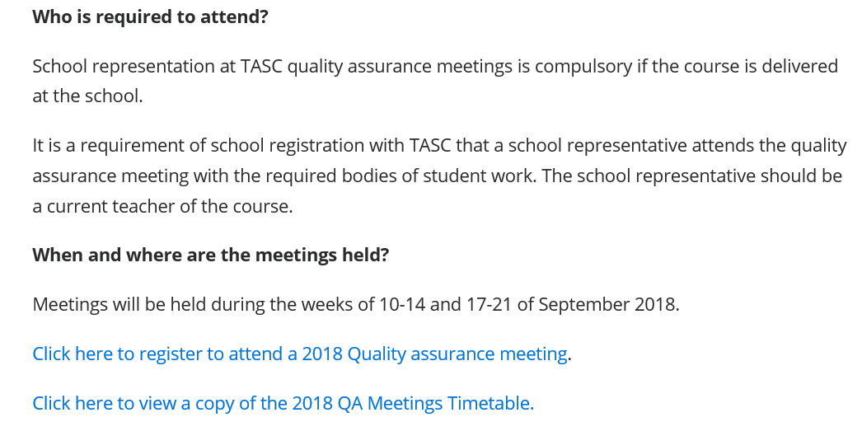
Individual provider representatives register by 31 August

Slide 9
QA meetings
Available on the TASC website:
individual course meeting requirements (since 5 March)
general information document (to help with form completion and responses to FAQs)
course-specific meeting details (dates and times) contained in the Meeting Timetable.

Slide 10
CHECK:
Is your scope up-to-date?
Are ‘provider ratings and awards’ based on internally moderated discussions?
Do teachers attending have all the information they need and know what to bring?
Registered to attend
where and when
required bodies of student work
completed cover forms.

Slide 11
‘hot topic’
Criteria and their standard elements
criteria are – in themselves –convenient headings under which standards are grouped. It is the standards that are used as the ‘measures’ of student achievement, not the criteria (headings).

Slide 12
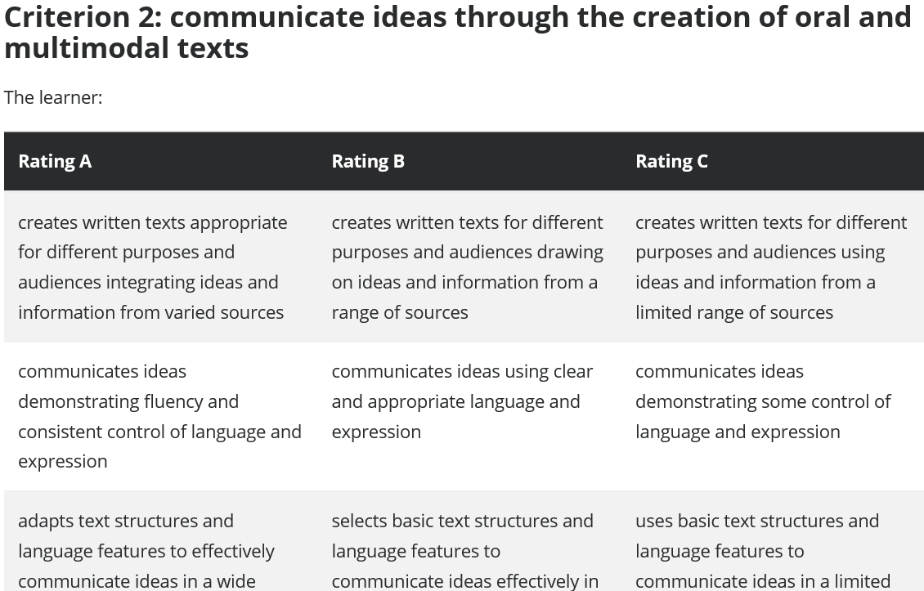
Criterion
Standard
Elements

Slide 13
Best Practice…
Enriching assessment matrixes, assessment tasks and records by the addition of notations about the specific standard elements assessed in each task adds clarity and increases the rigor of the checking process. Just as all criteria must be adequately assessed, so all standard elements of each criterion need to be assessed in the totality of the assessment.

Slide 14
TASC have not mandated that this should be included in scope and sequence but rather advised that it should be considered and students need to know what they are being assessed against!

